Slide 1

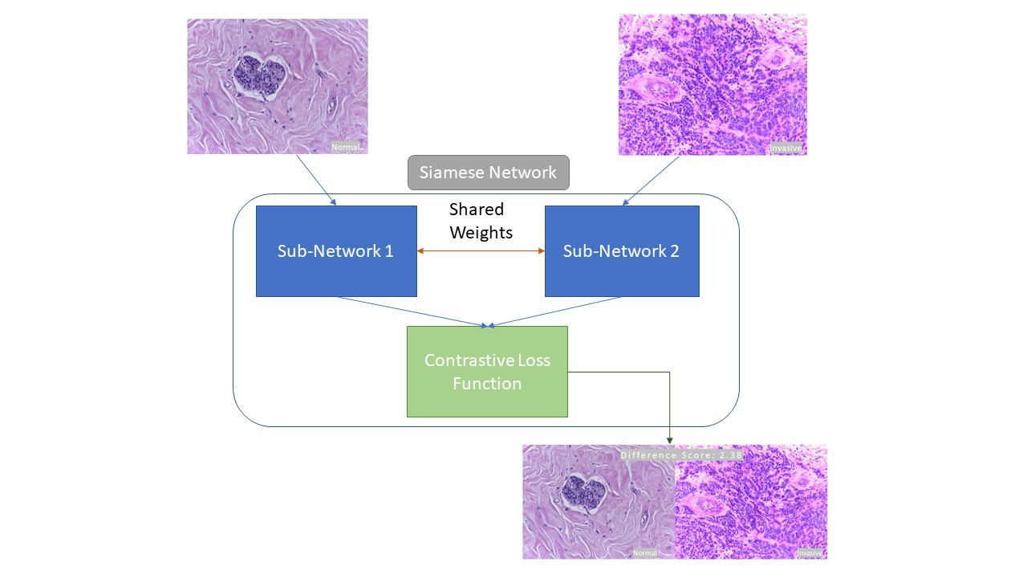


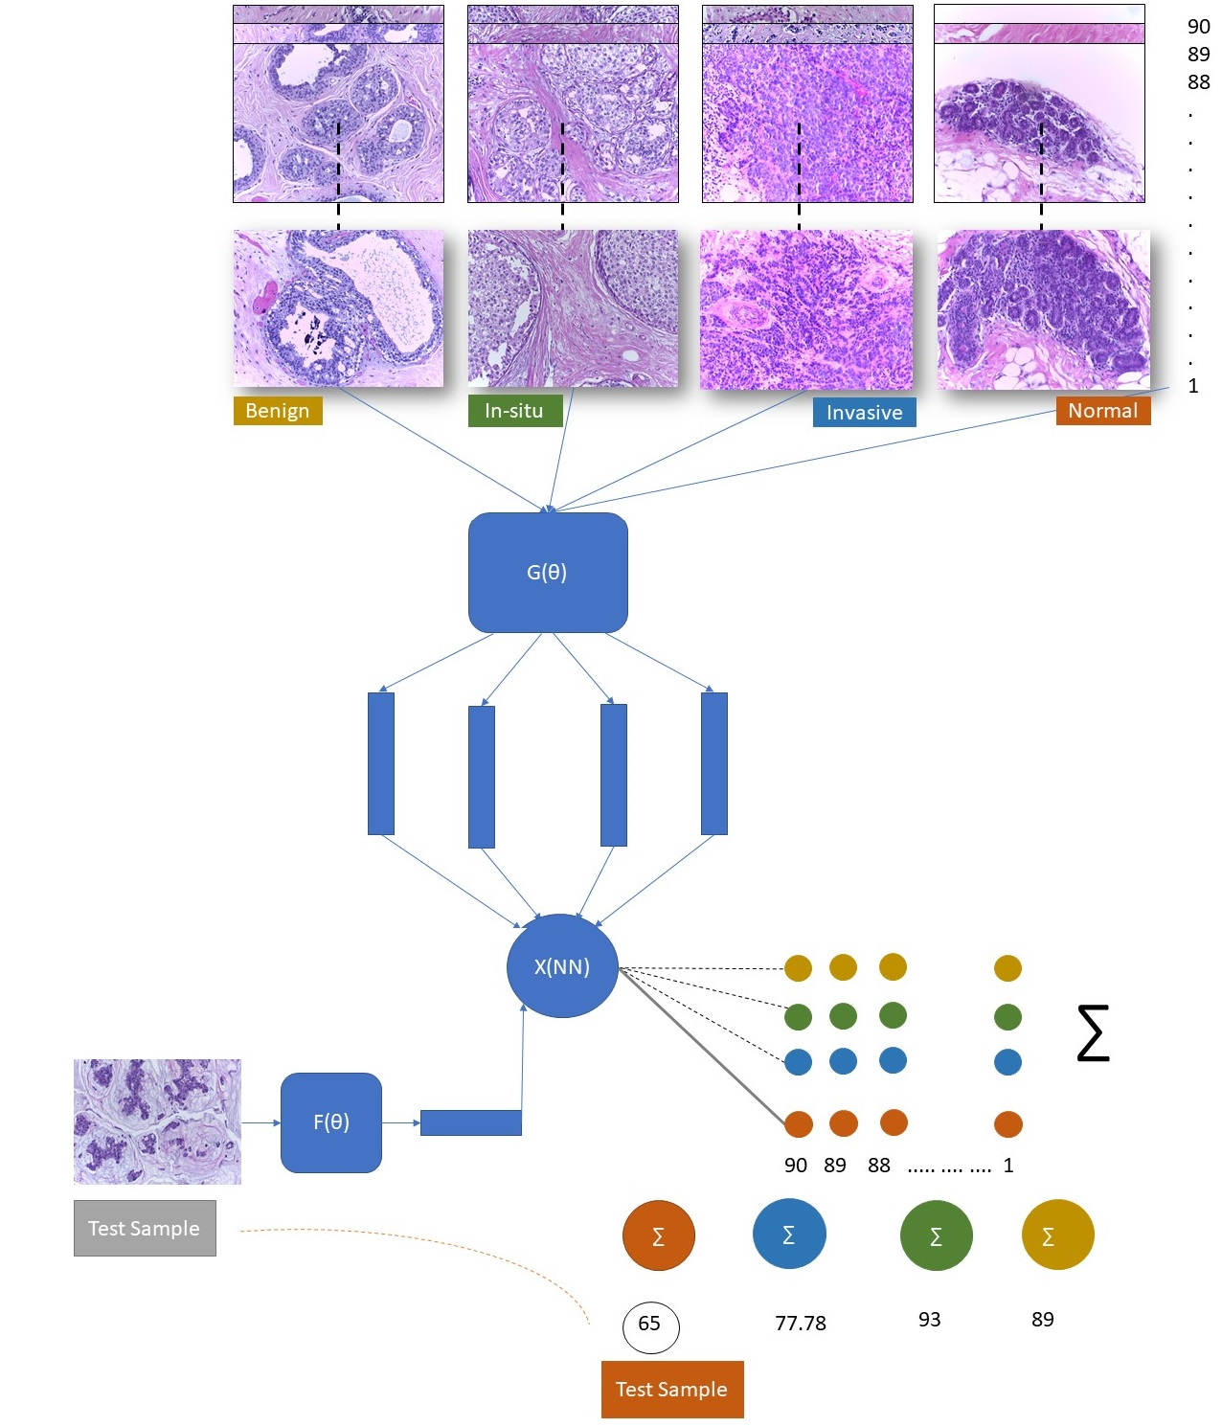
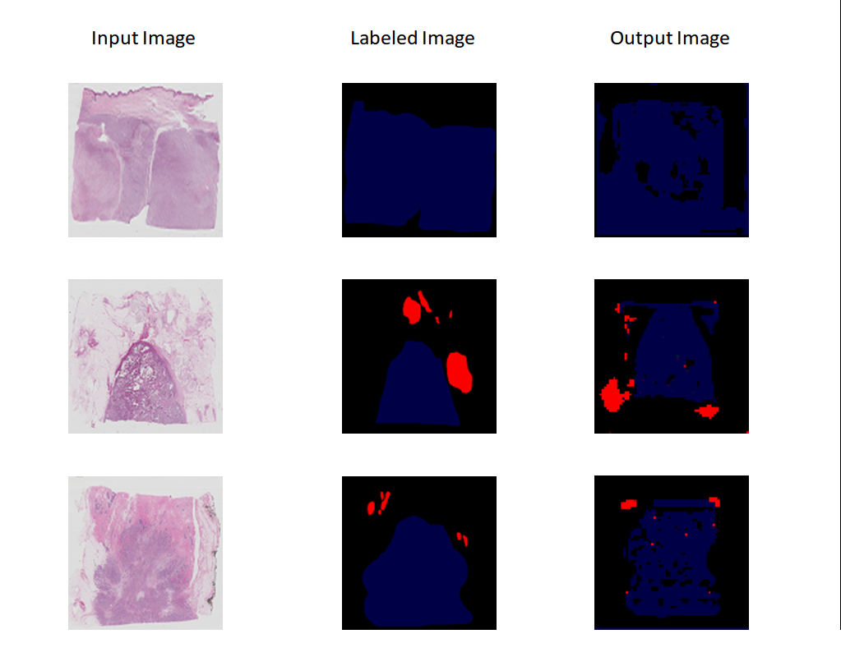
Approach to ICIAR 2018 Grand Challenge on Breast Cancer Histology images.
Gupta, Sangram MSc.¹ Dhingra, Naina MSc. Pai,Deepita MSc.³ Krishnan,Pooja MSc.⁴
¹sangram.gupta@tum.de, ²naina.dhingra@tum.de ³deepita.pai@tum.de, ⁴pooja.krishnan@tum.de
ABSTRACT
INTRODUCTION
Architecture & Experimental Results
Loss and Hyperparameters Metrics
The challenge hosted posed two problems.
First, given the images classify them as either Normal, Benign, In-situ, Invasive.
Initially we followed the baseline approach using standard State of the Art models AlexNet and Resnet18. We fine-tuned the existing models trained on ImageNet on Breast Cancer image dataset and achieved a classification accuracy 56.1% and 68% respectively. Next, we tried our experimental approach of using Siamese Network in which the sub network was AlexNet and then a variation of it both trained on tiny-Imagenet. The objective of using Siamese Network approach rested with weak classifier concept which we wanted to borrow.
Second, to label the whole slide images pixel wise. Implemented using the concept of Semantic Segmentation on Fully Convolutional Neural Network with pretrained VGG-16.
Implementation has been performed on Pytorch framework.
There are two goals in this challenge.
Part A of the challenge consists of automatically classifying H&E stained breast histology microscopy images into four classes: normal, benign, in situ carcinoma and invasive carcinoma.
Part B consists of performing pixel-wise labelling of whole-slide images in the same four classes. For this purpose, we have approx. 400+ labelled microscopy images, and 10 pixel-wise images.
Figure 1. Basic Siamese Network.
Part A
Loss Function:
Since a Siamese Network approach is used to differentiate two states(images) thus a natural loss function like Cross Entropy will not work. Instead we used “Contrastive Loss function”.
where m(margin): (0,1) || Y: 0 or 1 || Dw: distance(Euclidian) defined as follows.
Pre-processing:
• Inspired by Faster R-CNN paper we used Region of Interest cropping to get smaller but high-resolution parts of the complete image. (Independently)
• We used PCA for dimensionality reduction of images and use the complete image. (Independently)
Part B
We compute the loss using Cross Entropy in two dimensions. Initially we experimented with KL Divergence but as the fourth class was considered normal, it was thus irrelevant for performance evaluation.
Hyperparameter:
Learning rate : 10^-6 ; Epoch: 50 ; Momentum:0.99 ; Batch Size: 4
DATASET
Part A Microscopy images:
The dataset contains a total of 400 microscopy images, distributed as follows: Normal,Benign, in situ carcinoma,Invasive carcinoma each with 100.
Samples Microscopy images are in .tiff format and have the following specifications:
Color model: R(ed)G(reen)B(lue)
Size: 2048 x 1536 pixels
Pixel scale: 0.42 µm x 0.42 µm
Memory space: 10-20 MB (approx.)
Type of label: image-wise
Part B Whole-slide images :
Whole-slide (pixel-wise) images are in .svs format and have the following specifications:
Color model: R(ed)G(reen)B(lue)
Size: variable (eg: 42113 x 62625 pixels)
Pixel scale: 0,467 µ/pixel
Memory space: 8 GB (approx.)
Figure 2. Siamese with Bagging.
CONCLUSIONS
CONCLUSION
NETWORK SELECTED & APPROACH
Part A
With AlexNet on transfer learning we achieved an accuracy of 52.48% percent with Siamese subnetwork of Alexnet we obtained 56.1%.
Insights:
1. A deeper network will increase the performance
but so will the testing time from less than 2sec/image to almost 1-2min/image.
2. Testing time proportional to Dataset size.
Part B
Our model has an accuracy of 66.8% and can perform semantic segmentation with a loss of 0.27.
Insights:
Based on the accuracy and output we received, we believe that FCN 8 is not a recommended architecture to segment Bio-Medical Images. This challenge can be tried with Unet along with pretrained Resnet Model.
Part A
Baseline:
Fine Tuning on AlexNet, Transfer Learning on ResNet18
Experimental Approach:
Our approach is largely based on “Siamese Neural Networks for One-shot Image Recognition” by Gregory Koch with one to one comparison between training class image and the test image. The predicted class is the aggregation of least difference score generated per class when tested on all training images within a class. Rationale behind the approach included small dataset(400 images) and incorporating weak classifiers as in bagging to attain a strong classifier.
Part B
Baseline:
Transfer learning on VGG-16.
Experimental Approach:
Our approach is largely based on “Fully Convolutional Networks for Semantic Segmentation” .Model is based on FCN-8 architecture. We are performing semantic segmentation to label each pixel into 4 classes. As a part of Pre-processing Technique, we used Sampling to compress the large whole slide images. We used stochastic gradient descent as the optimizer.
Figure 3. Sample Outputs of Pixel-wise segmentation
GitHub Links
Part A: https://github.com/sangramioi/breast-cancer-detection-siamese-nn-bagging
Contact Email:
sangram.gupta@tum.de naina.dhingra@tum.de
Part B:
https://github.com/krishnanpooja/BACH-PixelWiseLabeling
Contact Email:
pooja.krishnan@tum.de
deepita.pai@tum.de
REFERENCES
Long, J., Shelhamer, E., Darrell, T.: Fully convolutional networks for semantic segmentation (2014), arXiv:1411.4038 [cs.CV]
Olaf R, Philipp Fi, Thomas B: U-Net: Convolutional Networks for Biomedical Image Segmentation
Koch G., Zemel R: Siamese Neural Networks for One-shot Image Recognition. ICML 2014 workshop.
R Hadsell, S Chopra, Y LeCun - Dimensionality Reduction by Learning an Invariant Mapping CVPR 2006

